Slide 1


DEPARTMENT OF COMPUTER SCIENCE AND ENGINEERING
20CS8504 & PROJECT WORK
END SEMESTER PRACTICAL EXAMINATION- APRIL / MAY - 2026
Batch No.:02
Date:30.03.2026
Session:FN

Slide 2
AN INTELLIGENT FRAMEWORK FOR MODELING AND SIMULATING STARTUP BUSINESS PROCESS
Guide Name:
Mrs.S.GAYATHRI AP/CSE
Team Members:
KAVIN KIRTHIK R P (811722104071)
NIKHAAL AHAMED A K (811722104101)
RAJESH R (811722104117)

Slide 3
OBJECTIVE OF THE PROJECT
1.Simulates the process of choosing a startup domains such as tech, healthcare, e-commerce, etc. based on market demand, risk level, and investment requirements.
2. Allows players to recruit employees based on skills, salary, and experience within a limited budget.
3. Simulates legal setup by allowing players to choose company type (Private Ltd, LLP, etc.) and complete compliance procedures.
4. Enables players to design product features, set pricing, allocate marketing budget, and launch the product.

Slide 4
INTRODUCTION
1. This project presents an intelligent startup simulation game that models real-world business processes using Unity and Large Language Models (LLM).
2. The system aims to provide an interactive platform where users can experience the lifecycle of a startup through gamified learning.
3. The framework integrates an LLM through the Ollama server to generate dynamic business scenarios, feedback, and market analysis in real time.
4. The game simulates four major phases of a startup: Domain Selection, Employee Hiring, Company Registration, and Product Deployment.
5. By combining AI intelligence with game mechanics, the project enhances entrepreneurial skills, strategic thinking, and decision-making abilities.

Slide 5
LITERATURE SURVEY
TITLE | AUTHORS | PAPER GIST | TECHNOLOGY USED
Promoting entrepreneurial intentions and competencies through business simulation games | Silitonga, L. M., Dharmawan, B., | Explains how business simulation games improve entrepreneurial thinking, decision-making skills, and practical business knowledge among students. | Entrepreneurship simulation games, digital gamified learning platforms
Serious games in higher education in the transforming process to Education 4.0—Systematized review | Brandl, L. C., & Schrader, A. | Reviews how serious games support Education 4.0 by improving interactive learning, digital skills, and student engagement. | Digital serious games, Education 4.0 technologies, interactive learning platforms
Learner engagement in a business simulation game | Huang, Y.-M., Murti, A. T., & Wu, T.-T. | Discusses how business simulation games increase student participation, motivation, and active learning in entrepreneurship education. | Digital business simulation game, interactive learning systems
Business simulation games for the development of intrinsic motivation-boosting sustainability | Vélez, A., Alonso, R. K., & Rico-González, M. | Shows how simulation games motivate learners to understand sustainable business practices and responsible decision making. | Digital sustainability simulation games, gamified learning platforms

Slide 6
TITLE | AUTHORS | PAPER GIST | TECHNOLOGY USED
Computer-based business games in higher education: A proposal of a gamified learning framework | Grijalvo, M., Segura, A., & Núñez, Y. | Proposes a gamified learning framework using computer-based business games to improve strategic thinking and learning outcomes. | Computer-based business games, gamified digital learning framework
Business simulation games in higher education | Faisal, N., Chadhar, M. | Explains the benefits of business simulation games for teaching management concepts, teamwork, and business strategy. | Computer-based business, digital learning environments
The effect of mobile business simulation games in entrepreneurship education | Chen, J., Tang, L., Tian, H., Ou | Examines how mobile-based business simulation games enhance entrepreneurship learning and improve student understanding of startup processes. | Mobile-based business simulation games, digital learning platforms

Slide 7
TITLE | AUTHORS | PAPER GIST | TECHNOLOGY USED
Business simulation games analysis supported by human-computer interfaces | Ferreira, C. P., González-González, C. S., & Adamatti, D. F. | The study shows that interactive simulations improve learning, engagement, and decision-making skills in business environments. | Human-Computer Interface (HCI), digital simulation systems, interactive gaming environments
Education for sustainable development through business simulation games | Gatti, L., Ulrich, M., & Seele, P. | This research studies how business simulation games can be used to teach sustainability concepts. | Sustainability-focused business simulation games, gamification platforms
Application of Serious Game Model on Simulation Training for Decision Makings of Project Management | Chen, H.-M., & Wei, K.-W. | It shows that simulation-based games improve decision-making ability, problem solving, and practical understanding of project management situations. | Serious game model, decision-making simulation systems

Slide 8
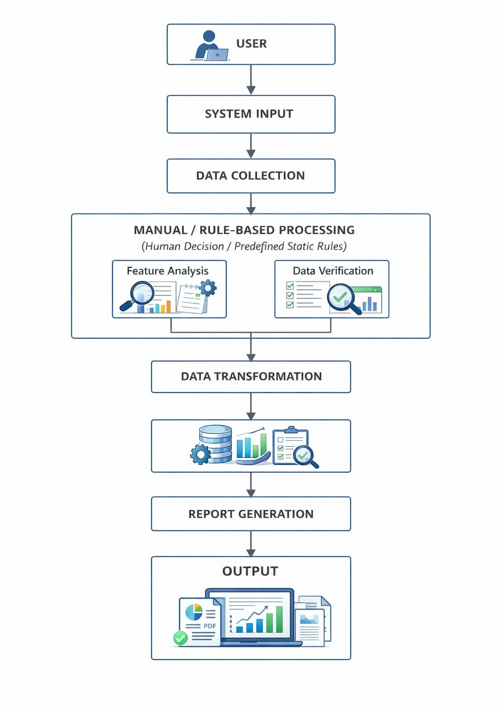
EXISTING SYSTEM ARCHITECTURE

Slide 9
PROBLEM IDENTIFICAITON
1. Lack of Practical Startup Learning – Many students learn entrepreneurship only through theory without real-world simulation.
2. Limited Interactive Business Training Tools – Existing systems do not provide interactive environments to practice startup decision-making.
3. Difficulty in Understanding Business Strategies – Beginners often struggle to understand funding, marketing, and resource management concepts.
4. Absence of Intelligent Feedback Systems – Most simulation platforms do not analyze user decisions or provide AI-based suggestions.
5. Lack of Realistic Startup Simulation Platforms – There are very few platforms that simulate the complete startup lifecycle from idea selection to product deployment.

Slide 10
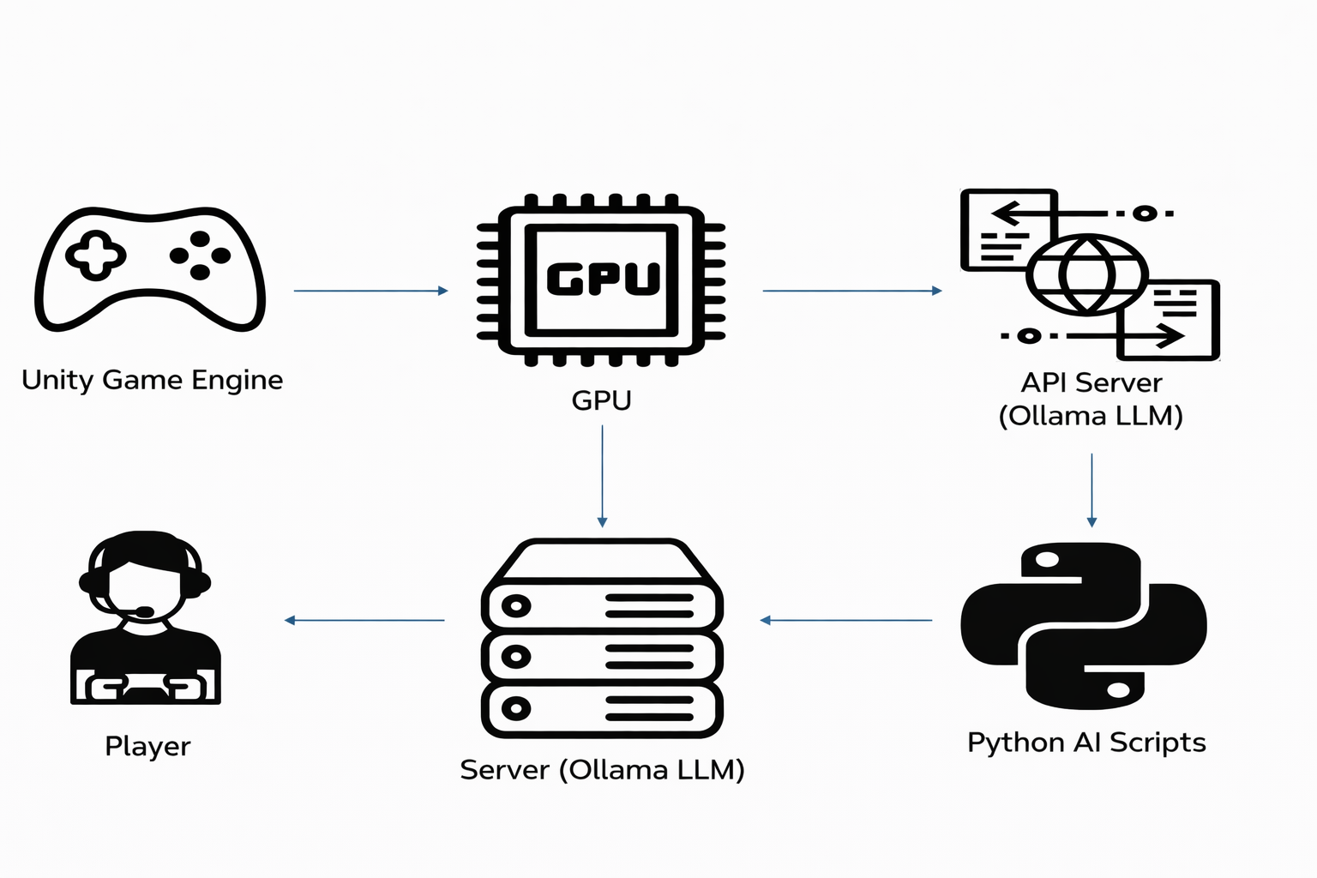
PROPOSED SYSTEM ARCHITECTURE

Slide 11
SOFTWARE AND HARDWARE REQUIREMENTS
HARDWARE
1.8GB RAM
2.Core i5 processor
3.256 GB SSD
4.Nvidia Rtx 2050
SOFTWARE
1. Windows 11
2. Unity game engine
3. Ollama

Slide 12
MODULES
1. Startup Business Process Modeling
2. AI-Driven Decision Support
3. Startup Lifecycle Simulation
4. Dynamic Market & Resource Management
5. Performance Evaluation & Startup Growth Analytics

Slide 13
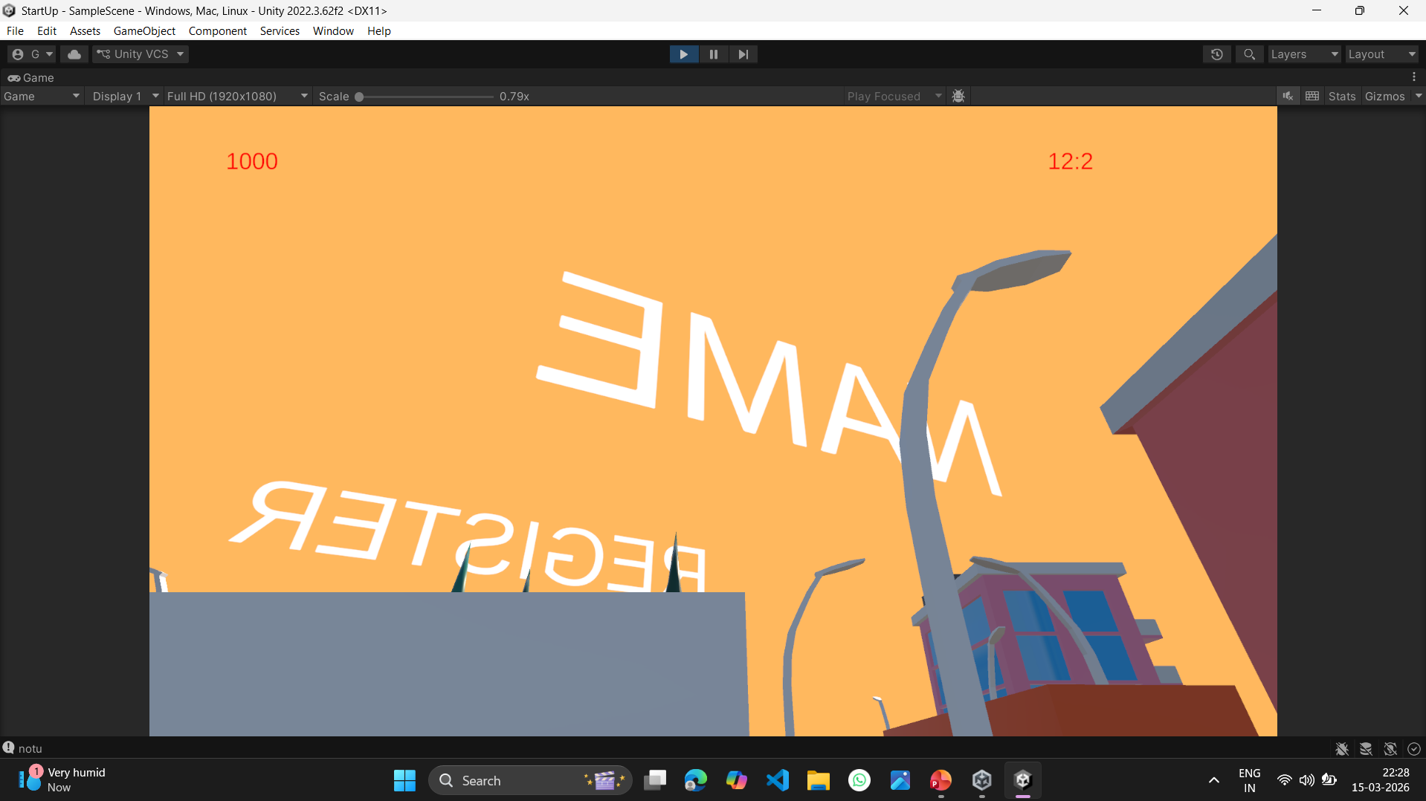
IMPLEMENTATION OF MODULE-1
Creates a coherent virtual environment that represents an evolving economic and decision-driven world.
Defines relationships between entities such as players, resources, markets, and external forces within the environment.
Establishes rules that govern interactions, progression, and consequences inside the simulated world.
Designs a logical flow that ensures consistency, realism, and continuity across different stages of the environment.

Slide 14
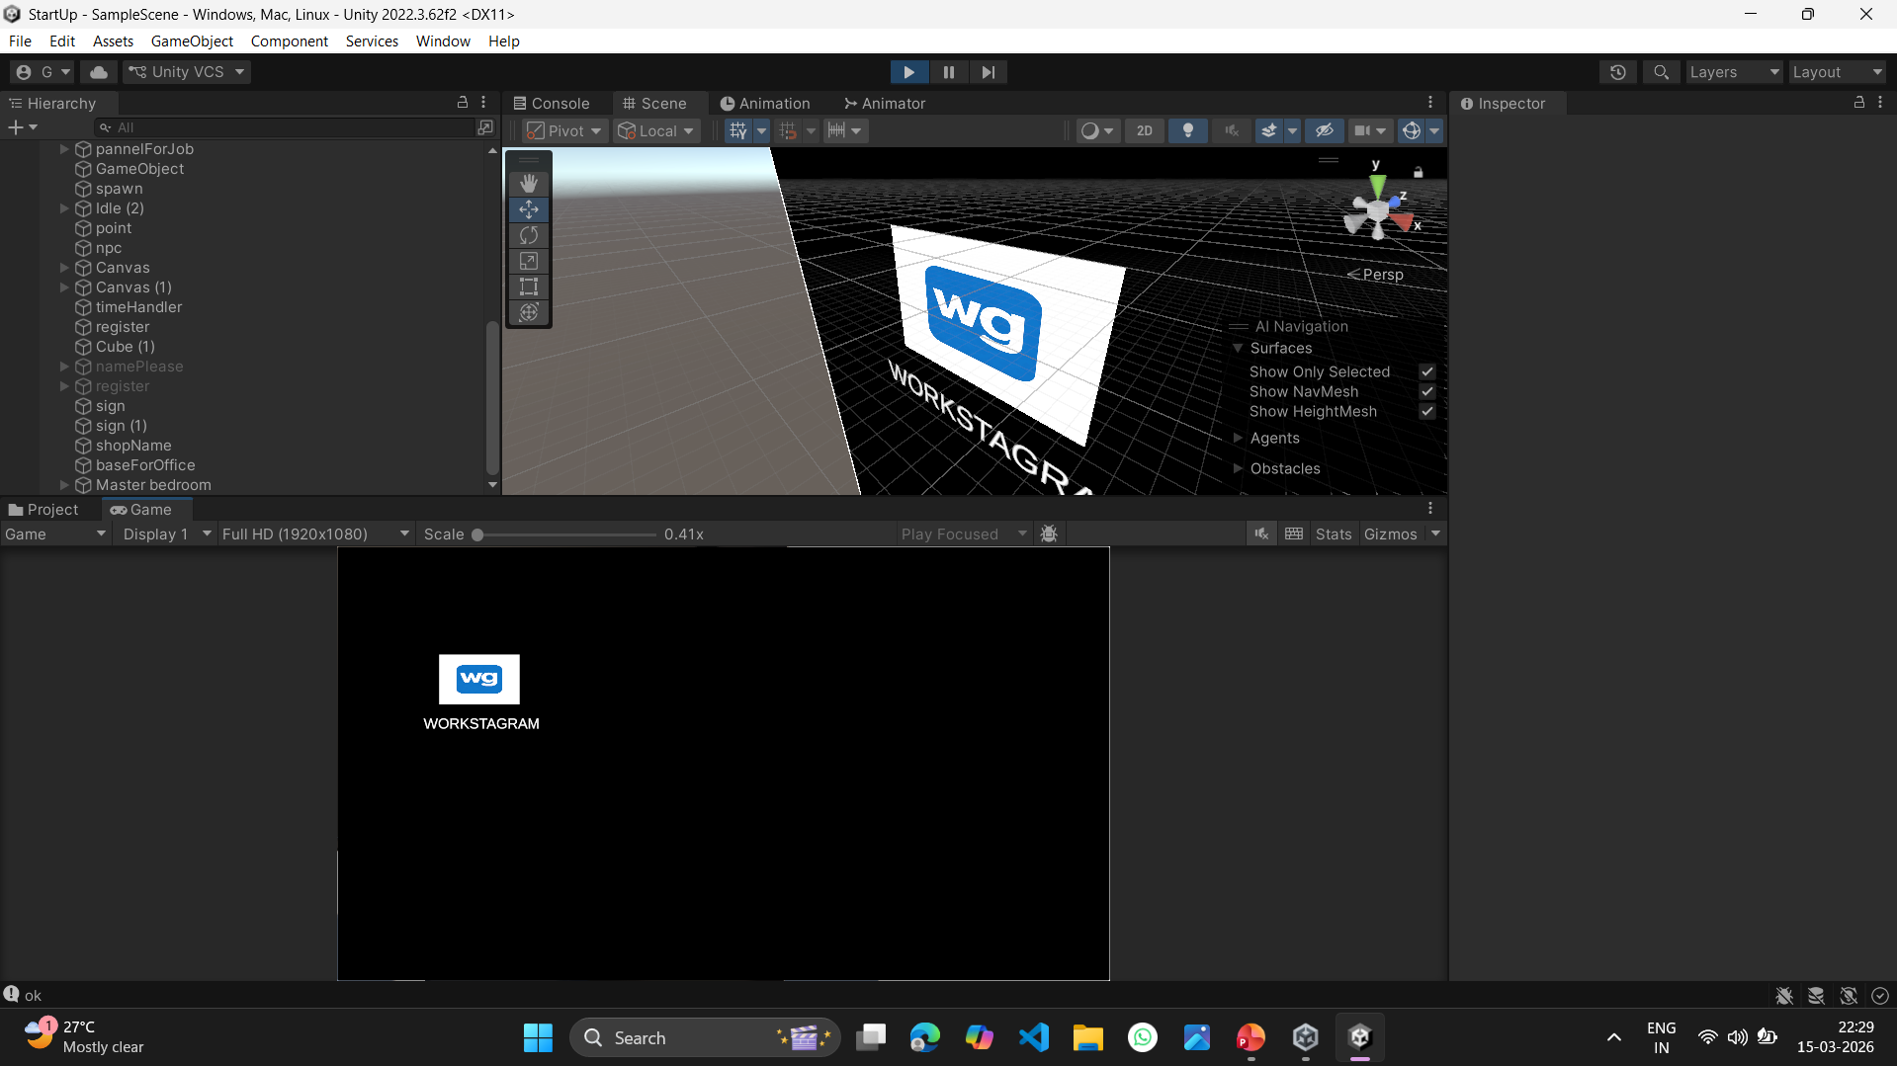
IMPLEMENTATION OF MODULE-2
Defines structured workflow of startup phases (domain to deployment).
Maps real-world business activities into system processes.
Models decision points based on entrepreneurial strategies.
Establishs rules, constraints, and business logic.
Aligns simulation flow with startup lifecycle theory.

Slide 15
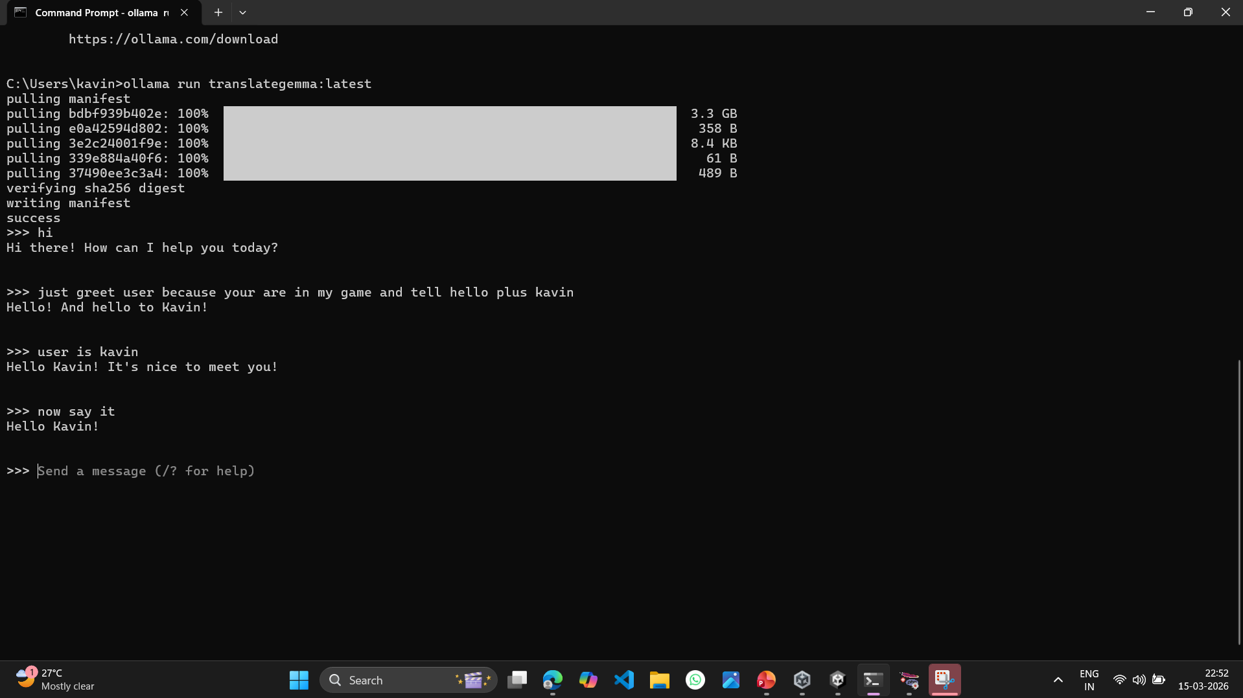
IMPLEMENTATION OF MODULE-3
Integrates LLM via Ollama for intelligent response generation.
Provides real-time business insights and recommendations.
Generates dynamic market scenarios and risk analysis.
Evaluates player decisions using AI reasoning.
Simulates investor, customer, and competitor feedback.

Slide 16
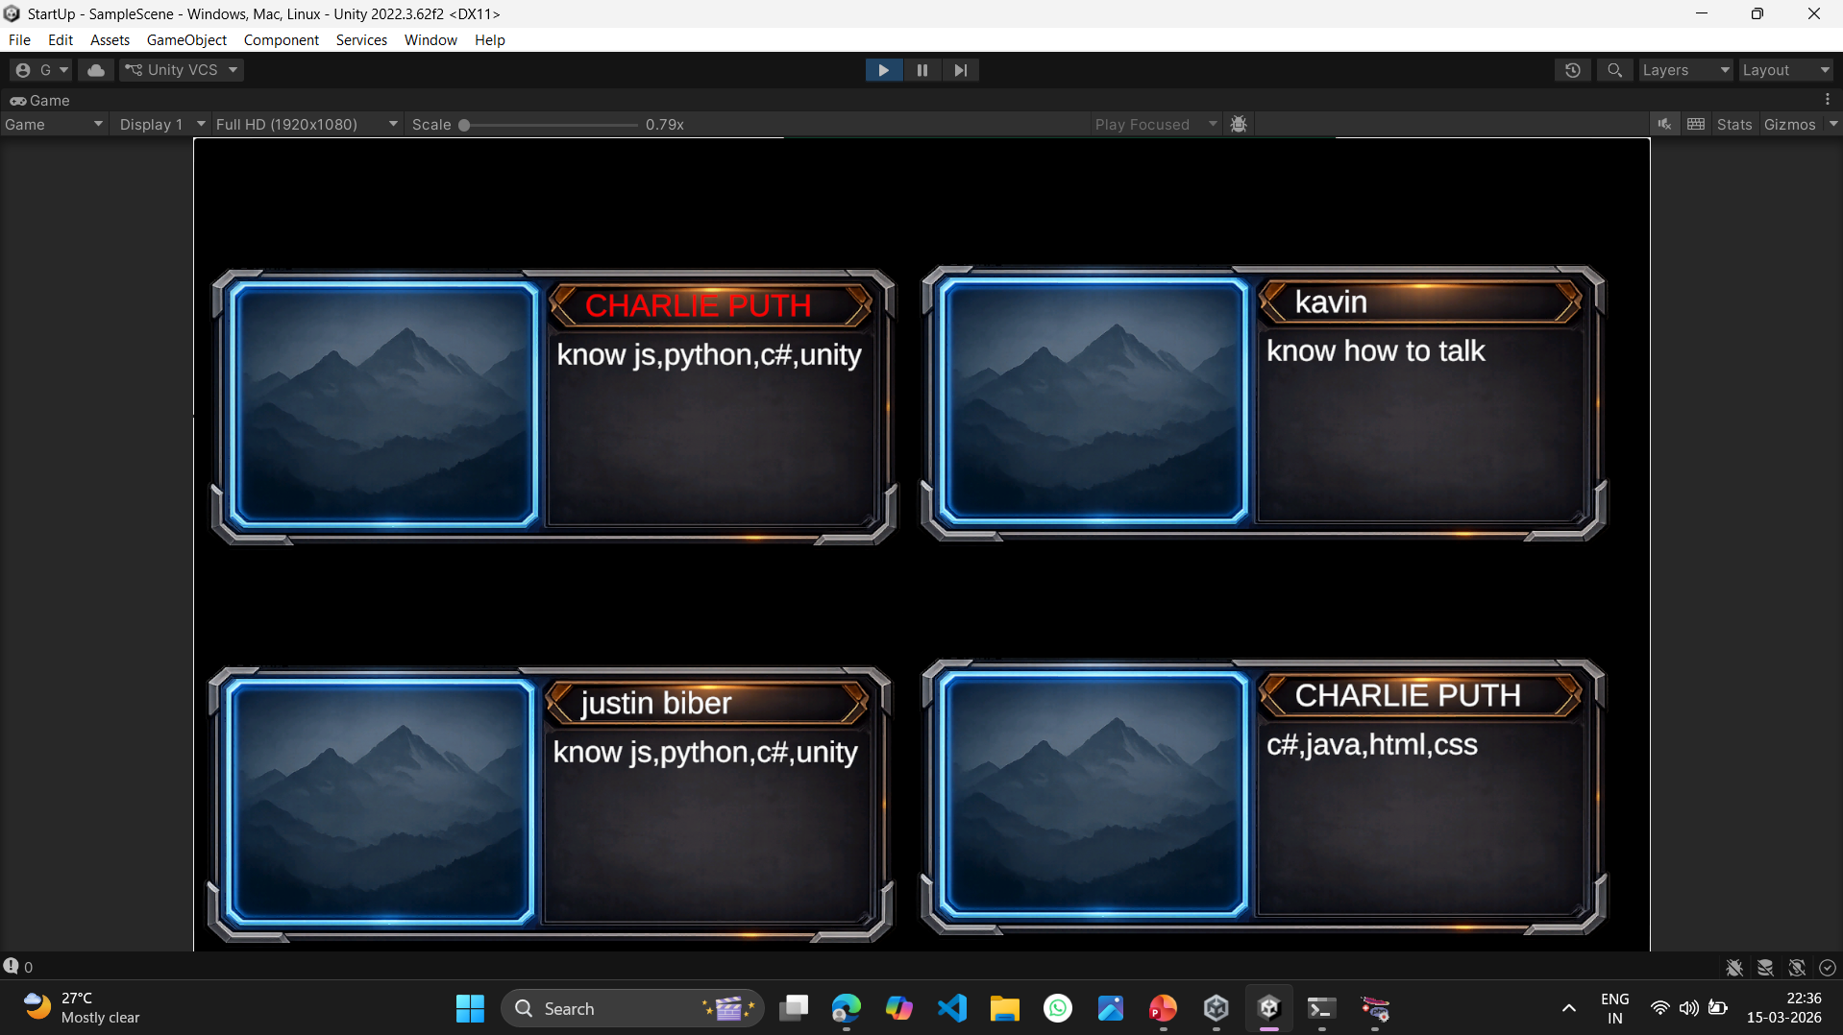
IMPLEMENTATION OF MODULE-4
Implements four startup phases as progressive game levels.
Simulates real-time business decision-making environment.
Allows player interaction with strategic choices.
Tracks experience points (XP) and level progression.
Creates immersive startup ecosystem using Unity engine.

Slide 17
IMPLEMENTATION OF MODULE-5
Simulates market demand and competition fluctuations.
Manages financial resources and operational costs.
Evaluates employee performance and productivity impact.
Adjusts business outcomes based on resource allocation.
Introduces uncertainty and risk factors dynamically.

Slide 18
CONCLUSION
The proposed framework successfully models and simulates real-world startup business processes through an interactive game environment.
Integration of LLM via Ollama enhances intelligent decision-making and dynamic scenario generation.
The system effectively improves strategic thinking, risk analysis, and entrepreneurial skills.
Unity-based simulation creates an engaging and experiential learning platform.
The project demonstrates that AI-driven business simulation games can support startup education and decision-making development.

Slide 19
FUTURE ENHANCEMENTS
Multiplayer Mode – Allow multiple players to create and manage startups in the same virtual market.
Advanced AI Support – Improve AI decision analysis using advanced machine learning techniques.
More Business Domains – Add more startup sectors like finance, healthcare, agriculture, and technology.
Better Graphics and UI – Improve game visuals, animations, and user interface for a better user experience.

